Slide 1
WEB TECHNOLOGIES PROJECT
BY:
M BENJAMIN PES2UG19CS204
NIDHI BHARATIYA PES2UG19CS254

Slide 2
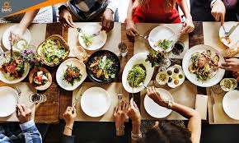
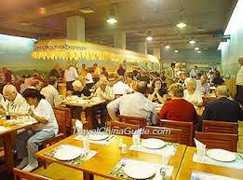
PROJECT TITLE:
FOOD AND DINING

Slide 3
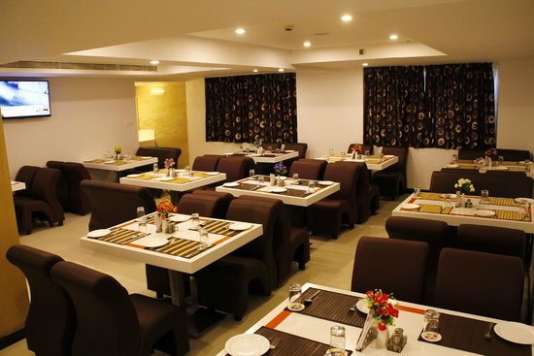
INTRODUCTION:
This project is solely based on how a normal hotel service in India looks like. This will be a fine dining hotel with a Indian cuisine menu. Certain features are additionally added in this website. The background details to be used for building this website will be:
Home Page which describes about Indian cuisine.
Menu page which displays the menu.
Gallery which has the photos of our restaurant.
Contact Details which will have the contact information of our restaurant.
A reservation of table form.

Slide 4
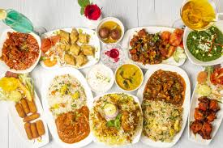
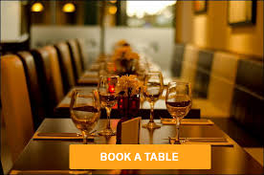
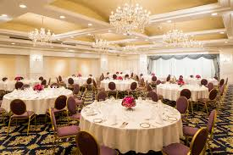
ABSTRACT:
This project is solely based on how a normal hotel service in India looks like. This will be a fine dining hotel with a multi cuisine menu(Mainly Indian) and location of this restaurant will be mentioned.
Features like booking table for customers, and takeaway options will be the main priorities of this project.
Photos of the restaurant, popular dishes of the day are also included to design this website.
KEYWORDS:
Multi-Cuisine(mainly Indian) menu
Book tables
Contact details of restaurant

Slide 5
About: 1)HOMEPAGE:
Our homepage consists of various features using Html,js,jquery,css and bootstrap modules.
We have added variety of animations when the page is reloaded.
The main features include:
An introduction about the cuisine our restaurant offers.
A navigation bar which is completely responsive and has hovering properties which makes It turn red when we place the cursor on it.
Information and beauty of Indian cuisine along with some images with added animations.
Discover Menu button.
Services we offer section which also has CSS properties.
A slides section which has a 5 second timer delay and automatically changes slides after a few seconds. It describes about the catering events we organise.
An interesting counter and a random number generator which counts till a random number everytime we scroll down.
A reservation(BOOK A TABLE) form.

Slide 6
2)MENU SECTION:
This has a menu card which includes a number of dishes.
A discover menu buttons.
Soups and Salads section. When we hover over the images of soups and salads, the price, name and the ingrediants of the dish are displayed.
Animations are added to all the images.
The main course section which works similarly.
Desserts section which also works similarly.
Reservation(Book a table) form.

Slide 7
CONTACT:
This page contains the contact details of our restaurant.
It consists of the address, phone numbers, and the opening hours.
Hovering over them results in the border colour to be red.

Slide 8
HTML FILES: 1)Index.html
This is our main html file which has various links to all the packages installed and the main html code.
It consists of all the div classes and ids which help us specify the particular properties and also the images to be pasted.

Slide 9
2)menu.html
This file consists of all the properties which have been used to design our menu section.

Slide 10
3)contact.html
This file consists of all the features which have been used to make the contact details section of our webpage.

Slide 11
OTHER FEATURES IN OUR WEBSITE:
When we scroll down, the end of our webpage consists of the information about our restaurant and some social media icons(which we got from favicon).
We also have a logo when we open our website next to our title from favicon.
Various fonts were used from google fonts and downloading them.
We downloaded the animation packages to create attractive and clean animations to the images and boxes.

Slide 12
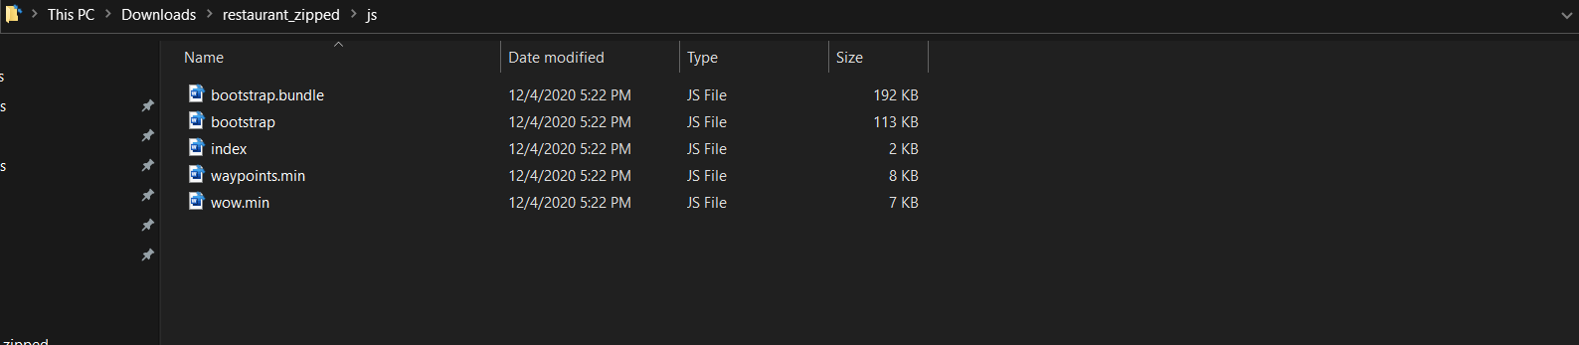
Our Java script folder consists of: bootstrap bundle(a package installed for bootstrap),bootstrap.js,index.js(javascript and functionality to the main html file),wow.min(for adding functionality to the animations).

Slide 13
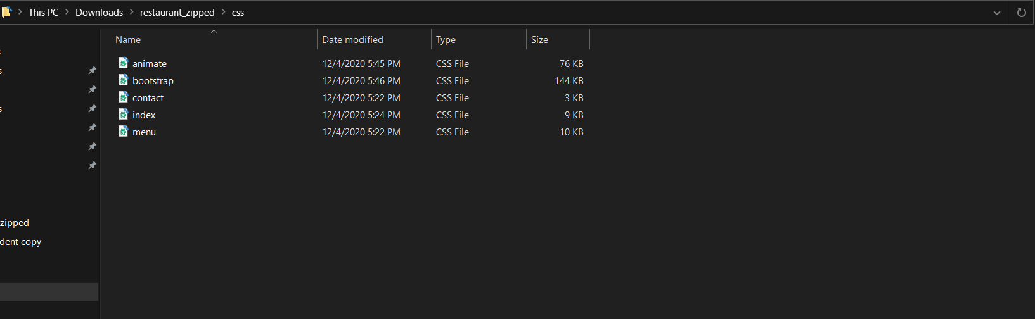
Our CSS folder consists of: animate.css(the animation bundle package installed),bootstrap.css,contact.css(css features to the contact section),index.css(css features to the main htm file and images), menu.css(css features to the menu section).

Slide 14
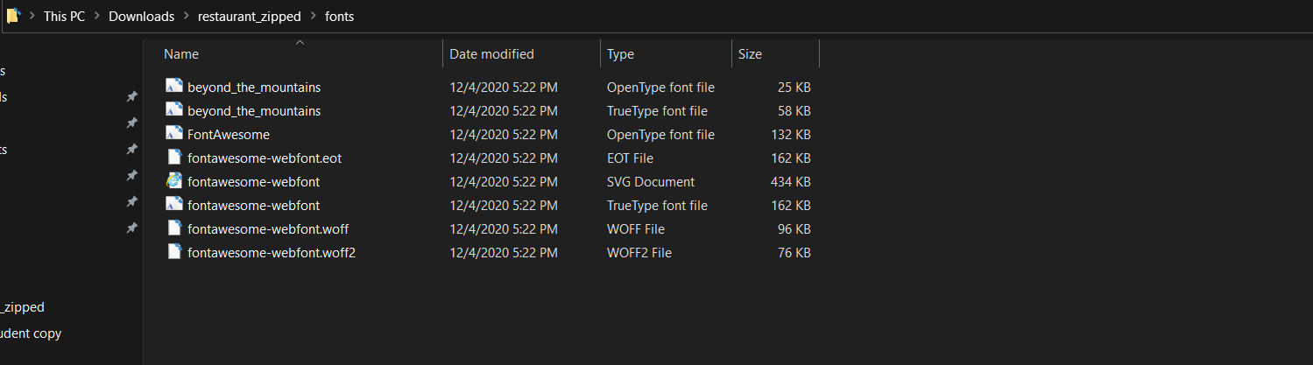
The fonts folder includes the google fonts which were downloaded for all the various sections.

Slide 15
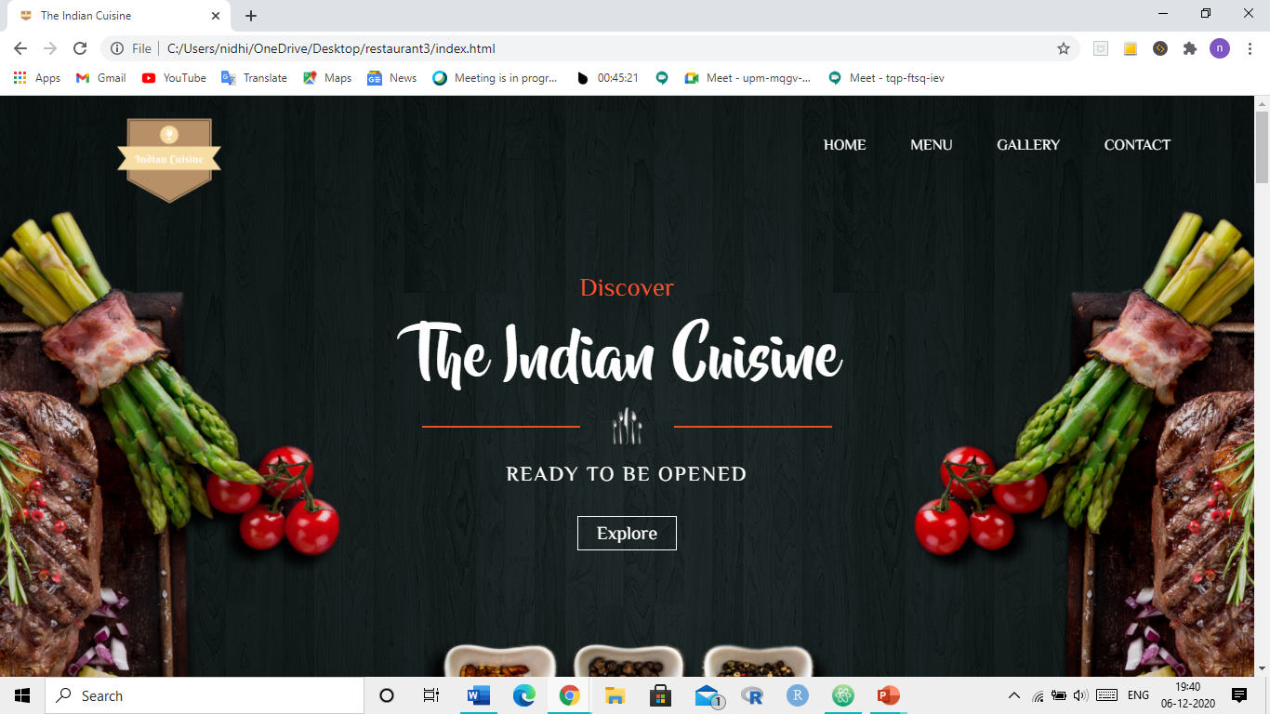
A GLIPMPSE OF OUR WEBSITE: HOME PAGE:

Slide 16
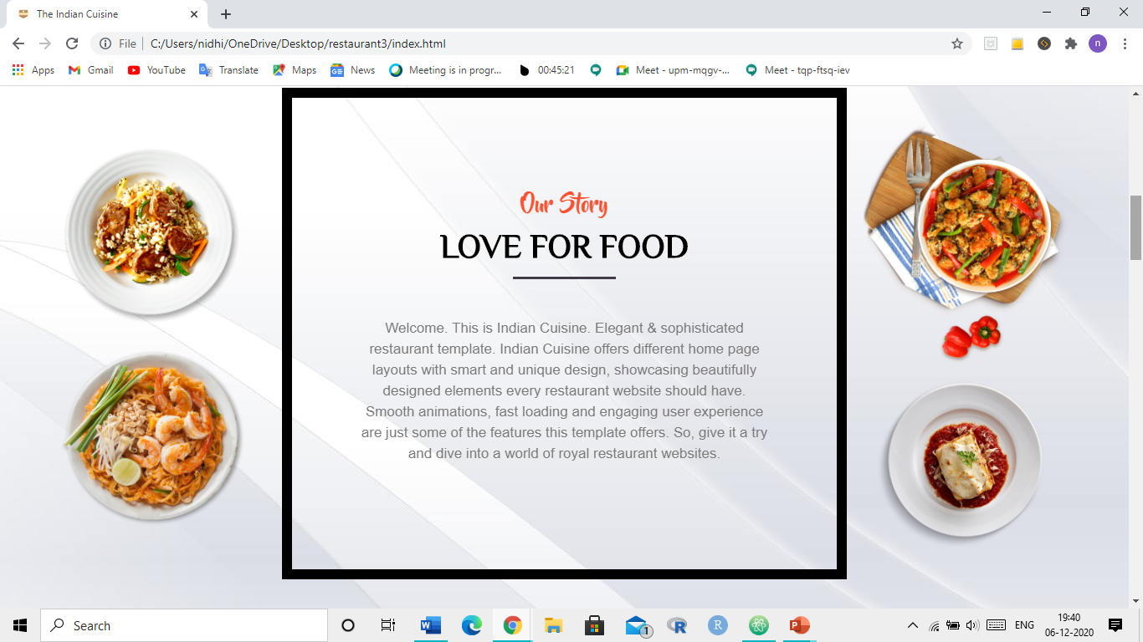
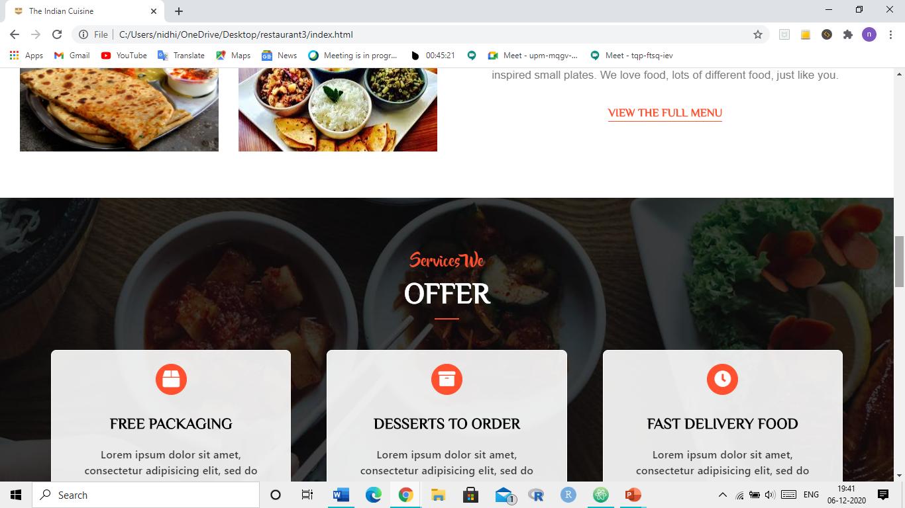

Slide 17
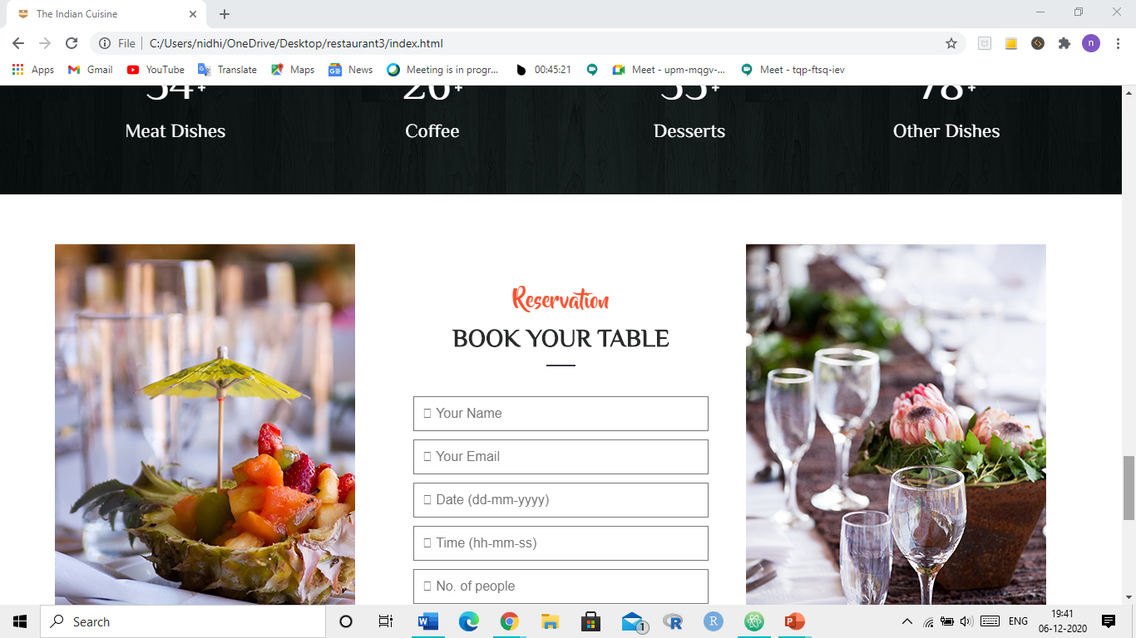

Slide 18
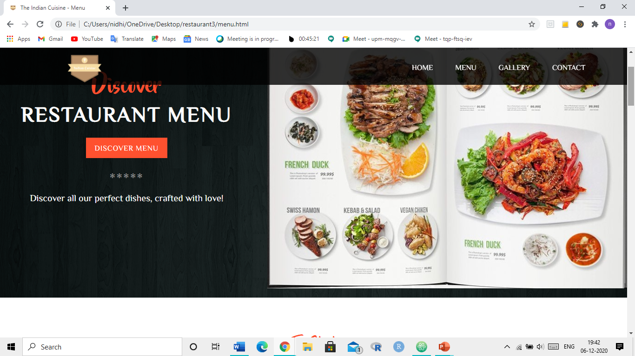
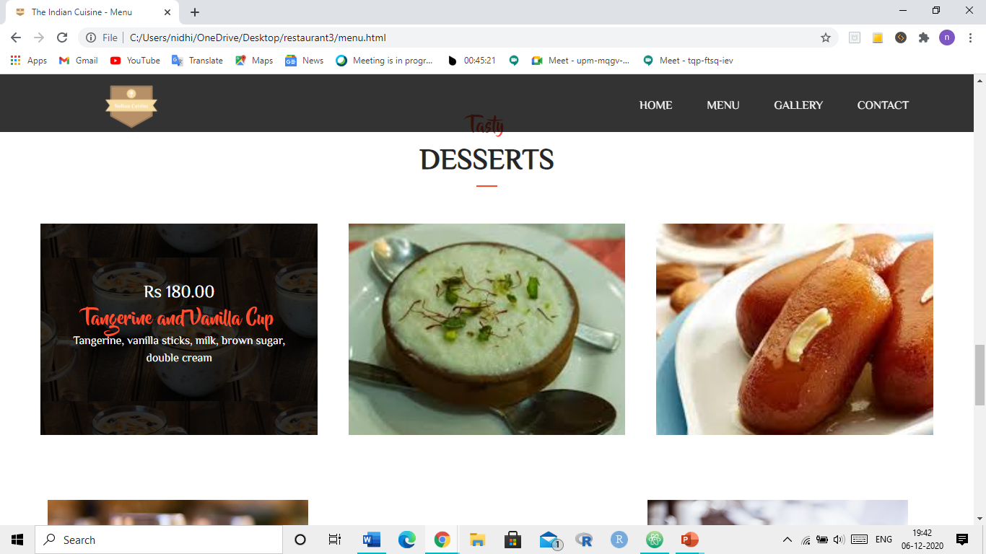
Menu page:

Slide 19
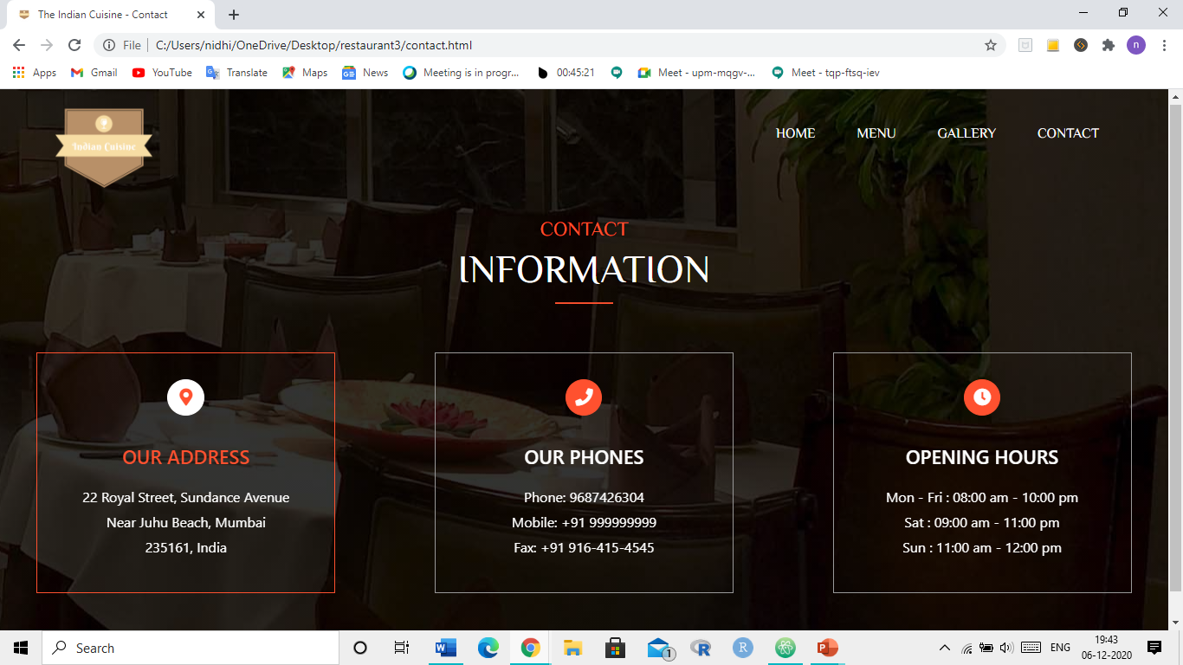
CONTACT:

Slide 20
TECHNOLOGIES USED:
BOOTSTRAP 4
JQUERY
JAVASCRIPT
ANIMATE.CSS
ANIMATE.JS
FONTAWESOME
GOOGLE FONTS
FAVICON

Slide 21
CONTRIBUTIONS
FRONT END:
NIDHI BHARATIYA
BACKEND:
M BENJAMIN

Slide 22
LINK TO THE GITHUB REPOSITORY
https://github.com/nidhib17/Web-Technology-Project-on-fine-dining-Restaurant

